Slide 1


Wine Quality Prediction
Computer Science
Jiayao Pang
194174300

Slide 2

contents
Instruction
Data Exploration
Model Construction
Demonstration

Slide 3


Instructions
How to determine the price & quality?
Input:
11 features
fixed acidity
volatile acidity
…
alcohol
Output:
A value range [0, 10]

Slide 4
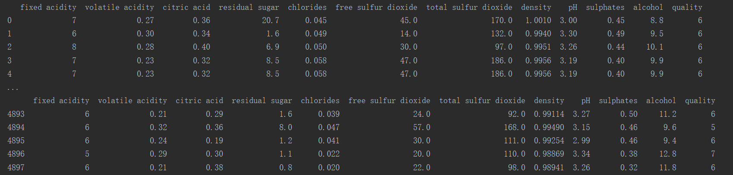
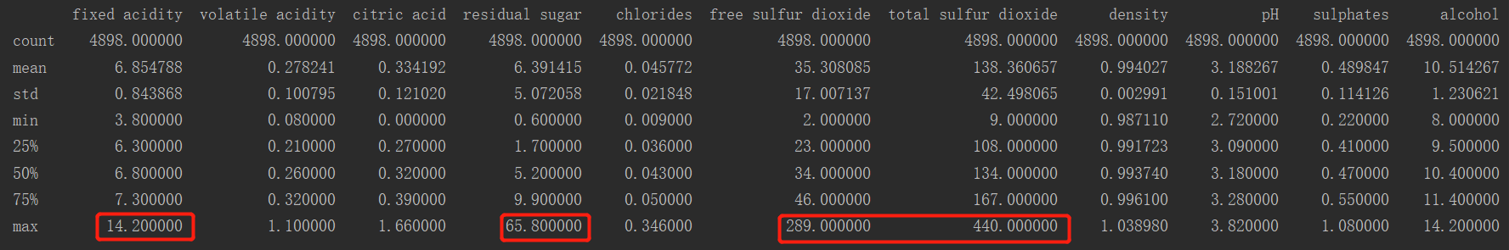
Data Exploration
ABT
Quality
report

Slide 5
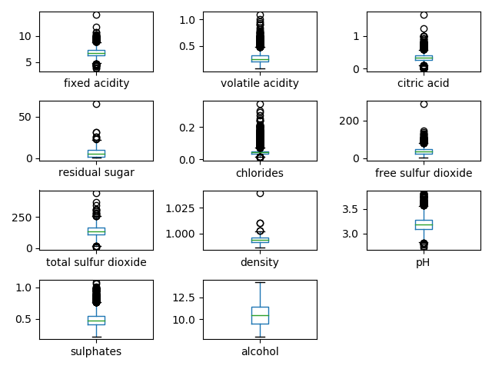
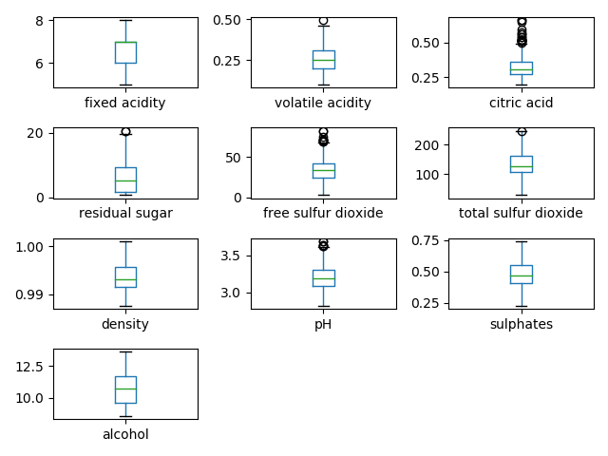
Data Exploration --- Outliers
Before
After

Slide 6
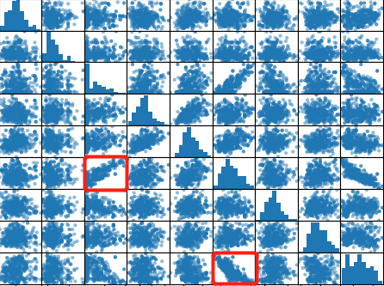
Data Exploration --- Relationship (continuous & continuous)
Strong linear relationship between feature ‘residual sugar’ and ‘density’ and also between feature ‘alcohol’ and ‘density’

Slide 7
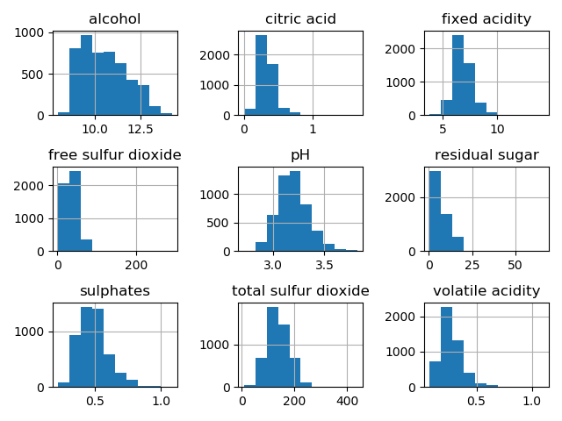
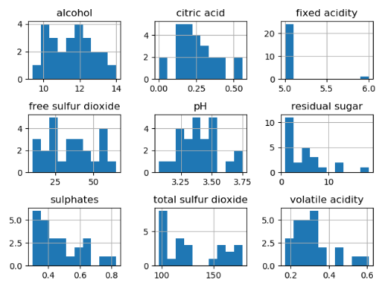
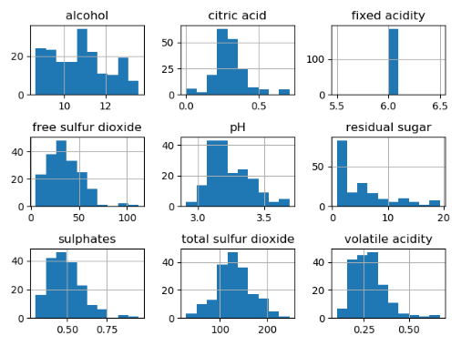
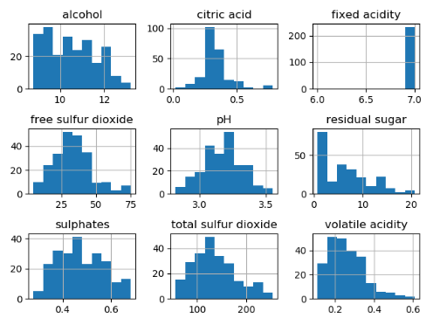
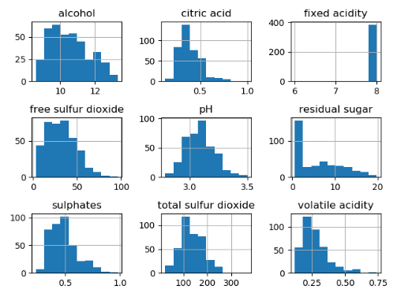
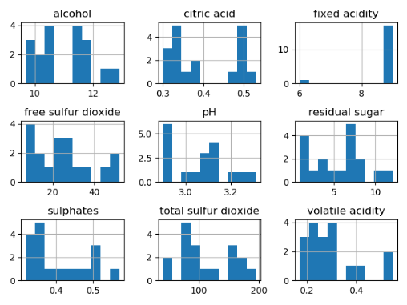
Data Exploration --- Relationship (categorical & continuous)
original
fixed acidity = 5
fixed acidity = 6
fixed acidity = 7
fixed acidity = 8
fixed acidity = 9

Slide 8

Model Construction
linear regression with gradient descent
Error-based learning
Data partitioning
11 descriptive features
High dimension
80% & 20%

Slide 9
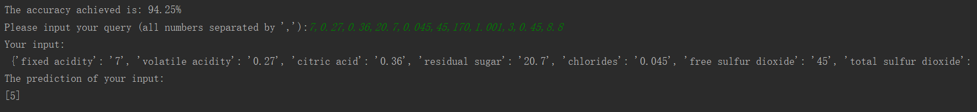
Demonstration
Output the training accuracy → Ask for the input →
Convert to ‘dict’ → Convert to pandas.DateFrame() →
Output the prediction

Slide 10
Thank you!
Computer Science
Jiayao Pang
194174300

